Slide 1
Intruduction to Image Compression Techniques
Date: 2011.11.23
Advisor: Jian-Jung Ding
Reporter: Hsin-Hui Chen

Slide 2
Introduction
Vector Quantization(VQ)-Based Image Coding
Block Truncation Coding(BTC)
Wavelet-Based Image Coding

Slide 3
VQ-Based Image Coding
Scalar Quantization (SQ)
A real number
Vector Quantization (VQ)
A set of real numbers

Slide 4
VQ-Based Image Coding
Vector Quantization (VQ)
Side-Match Vector Quantization (SMVQ)
Classified Vector Quantization (CVQ)
Tree Structured Vector Quantization (TSVQ)

Slide 5
VQ-Based Image Coding
Drawbacks of VQ
Block Effect
Time Complexity for LBG algorithm
Block Effect
SMVQ
Derailment
CSMVQ
Time Complexity
CVQ
TSVQ
PCA

Slide 6
Vector Quantization
Encoder
Find the closest codeword
Codebook
w
…
codeword
i
…
i
k
…
…
…
Index Table
Original Image
k = w x h

Slide 7
Vector Quantization
Output: i
Codebook
codeword
i

Slide 8
Vector Quantization
Decoder
Codebook
Look-up Table
w
codeword
Reconstructed Image
h
k
i
Similar block
Index Table
k = w x h

Slide 9
Codebook Generation Algorithm
LBG
Splitting

Slide 10
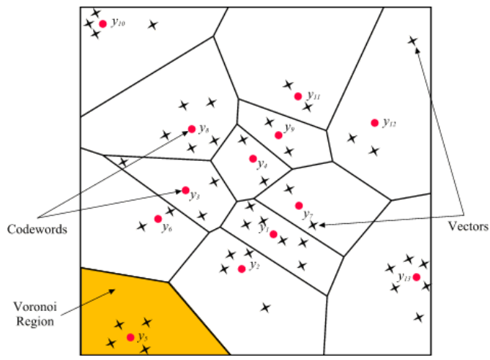
LBG Algorithm

Slide 11
Demo for Splitting Algorithm

Slide 12
Drawback of VQ
Block Effect

Slide 13
Side Match Vector Quantization
Seed blocks
…
=>VQ
…
Residual blocks
…
…
…
=>SMVQ
Original Image

Slide 14
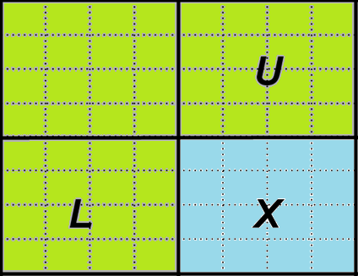
Side Match Vector Quantization
State Codebook
Generate
codeword
Super Codebook
(Traditional VQ
Codebook)

Slide 15
Side Match Vector Quantization
Super Codebook
codeword
167
150
122
101
133
150
150
122
101
129
129
118
118
123
123
Find N Closest Codewords from Super Codebook

Slide 16
Drawback of SMVQ
Derailment

Slide 17
Solution to Derailment
State Codebook
codeword
Error <= TH
Super Codebook
codeword
Error > TH

Slide 18
Cost
Block indicator:
Bit “1” => VQ
Bit “0”=> SMVQ

Slide 19
Classified Side Match Vector Quantization
Compared to SMVQ:
More Robust to derailment
But less coding efficiency

Slide 20
Classified Side Match Vector Quantization
Two Thresholds:
THc
THD
Size
State Codebook
Choose one
Super Codebook

Slide 21
Classified Side Match Vector Quantization
State Codebook Size Decision
If Var(U)<=THc and Var(V)<=THc :
Class(X)=1
If (Var(U)<=THc and Var(V)>THc ) or
(Var(U)>THc and Var(V)<=THc ):
Class(X)=2
If Var(U)>THc and Var(V)>THc:
Class(X)=3

Slide 22
Classified Side Match Vector Quantization
Three State Codebooks:
N
Class(X)=1
2N
Class(X)=2
4N
Class(X)=3

Slide 23
Classified Side Match Vector Quantization
min(X,CWi)<=THD
State Codebook
CWi
min(X, CWi)>THD
Super Codebook

Slide 24
Drawback of LBG Algorithm
Spent much time to full search

Slide 25
Drawback of LBG Algorithm
Full Search
Find the closest codeword
Codebook
w
…
codeword
i
…
i
k
…
…
…
Index Table
Original Image
k = w x h

Slide 26
Solution to Time Complexity
Classified Vector Quantization (CVQ)
Tree Structured Vector Quantization (TSVQ)
Principal Component Analysis (PCA)

Slide 27
Classified Vector Quantization
Comparable image quality to VQ
Less computational time

Slide 28
Classified Vector Quantization
Encoder
CVQ Encoder
Output index
w
…
…
Block
Classifier
…
…
…
Original Image
……
Codebook1
Codebook2
Codebook N

Slide 29
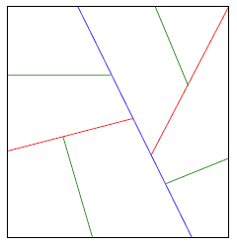
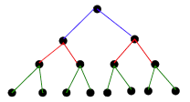
Tree Structured Vector Quantization
VQ Codebook
Tree Structured VQ Codebook

Slide 30
Principal Component Analysis
Codebook
codeword
Covariance Matrix
i
K
C
K x K
M x K

Slide 31
Principal Component Analysis
Covariance Matrix
V
CV=VD
C
K x K
K x K
D
V: Eigenvectors matrix
D: Eigenvalues matrix
K x K

Slide 32
Principal Component Analysis
sort
V
Find the eigenvector with
the largest eigenvalue
K x K
Projection coordinate
D
V: Eigenvectors matrix
D: Eigenvalues matrix
K x K

Slide 33
Principal Component Analysis
Codebook
codeword
i
K
Projection coordinate
Codebook Projection
Values
M x K

Slide 34
Principal Component Analysis
Codebook
codeword
i
K
Codebook Projection
Values
M x K

Slide 35
Principal Component Analysis
…
Projection coordinate
Projection value
…
Find the closest codebook
projection value
Codebook
…
codeword
…
…
K
Original Image
i
i
Search Range
Codebook Projection Values

Slide 36
Block Truncation Coding
BTC
…
Bit map
…
a
b
…
…
…
Original Image

Slide 37
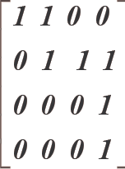
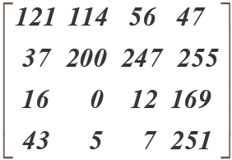
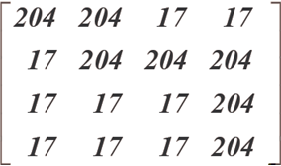
Block Truncation Coding
An Example:
Bit map
a
b
Original Block
Average Value
Reconstructed Block

Slide 38
Wavelet-Based Image Coding
Embedded Zero Wavelet (EZW)
Set Partitioning in Hierarchical Tree(SPIHT)
JPEG2000

Slide 39
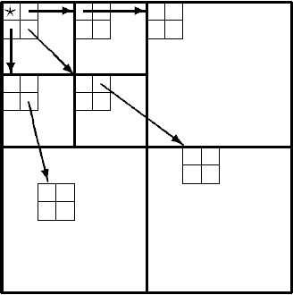
Wavelet-Based Image Coding
Parent-Descendant Relationship

Slide 40
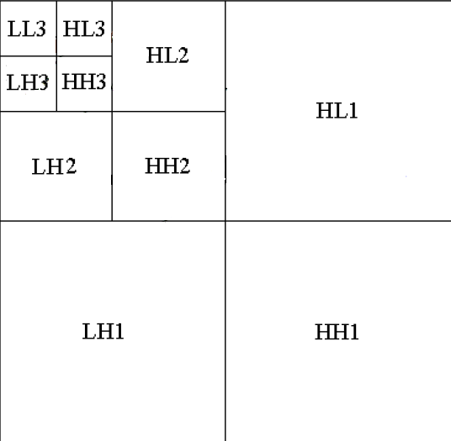
Wavelet-Based Image Coding
Scan Order
Thresholds
Bitstream
101001110….

Slide 41
Q&A
Q&A

